Slide 1
AGENDA OF LECTURE 5,6,7
Topics to Be Covered:
Structure of os
System call

Slide 2
Operating System Design and Implementation
Design and Implementation of OS not “solvable”, but
some approaches have proven successful
Internal structure of different Operating Systems can vary widely
Start the design by defining goals and specifications
Affected by choice of hardware, type of system
User goals and System goals
User goals – operating system should be convenient to use,
easy to learn, reliable, safe, and fast
System goals – operating system should be easy to design, implement, and maintain, as well as flexible, reliable, error- free, and efficient

Slide 3
Operating System Structure
General-purpose OS is very large program
Various ways to structure ones
Simple structure – MS-DOS
More complex -- UNIX
Layered – an abstracation
Microkernel -Mach

Slide 4
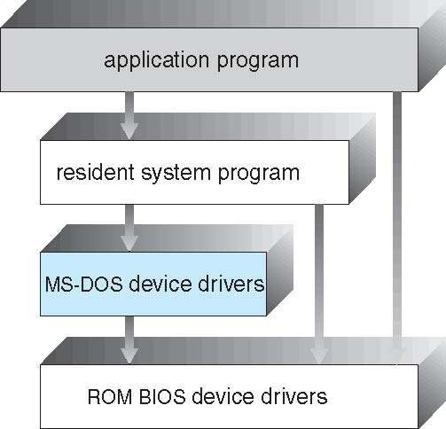
Simple Structure -- MS-DOS
MS-DOS | – | written |  | to
provide functionality space |  | the in | the | most least
Not divided into modules
Although MS-DOS has some structure, its interfaces and levels of functionality are not well separated

Slide 5
Non Simple Structure -- UNIX
UNIX – limited by hardware functionality, the original UNIX operating
system had limited structuring.
parts
Systems programs
The kernel
The UNIX OS consists of two separable
Consists of everything below the system-call interface and above the
physical hardware
Provides the file system, CPU scheduling, memory management, and other operating-system functions; a large number of functions for one level

Slide 6
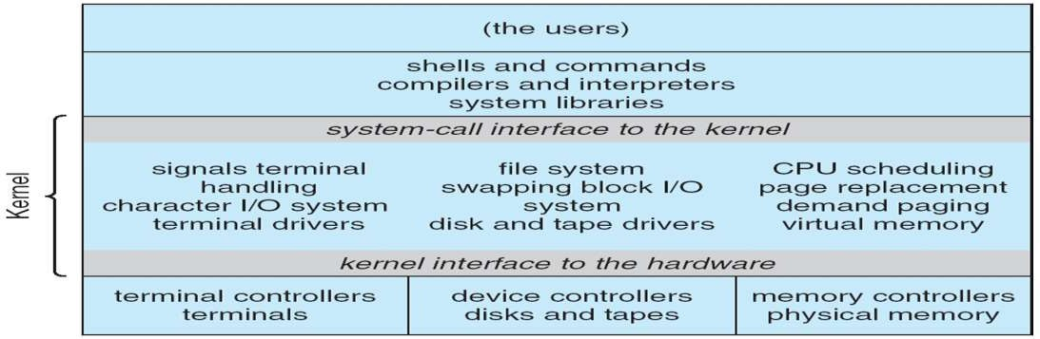
Traditional UNIX System Structure
Beyond simple but not fully layered

Slide 7
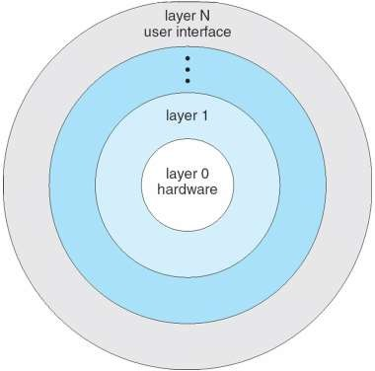
Layered Approach
The operating divided into a
system is number of
layers (levels), each built on top of lower layers. The bottom layer (layer 0), is the hardware; the highest (layer
N) is the user interface.
With modularity, layers are selected such that each uses functions (operations) and services of only lower-level layers

Slide 8
Microkernel System Structure
Moves as much from the kernel into user space
Mach example of microkernel
Mac OS X kernel (Darwin) partly based on Mach
Communication takes place between user modules using message passing
Benefits:
Easier to extend a microkernel
Easier to port the operating system to new architectures
More reliable (less code is running in kernel mode)
More secure
Detriments:
Performance overhead of user space to kernel space communication

Slide 9
Microkernel System Structure
Application Program
File System
Device Driver
user mode
messages
messages
Interprocess Communication
memory managment
CPU
scheduling
kernel mode
microkernel
hardware

Slide 10
Modules
Many modern operating systems implement loadable kernel modules
Uses object-oriented approach
Each core component is separate
Each talks to the others over known interfaces
Each is loadable as needed within the kernel
Overall, similar to layers but with more flexible
Linux, Solaris, etc

Slide 11
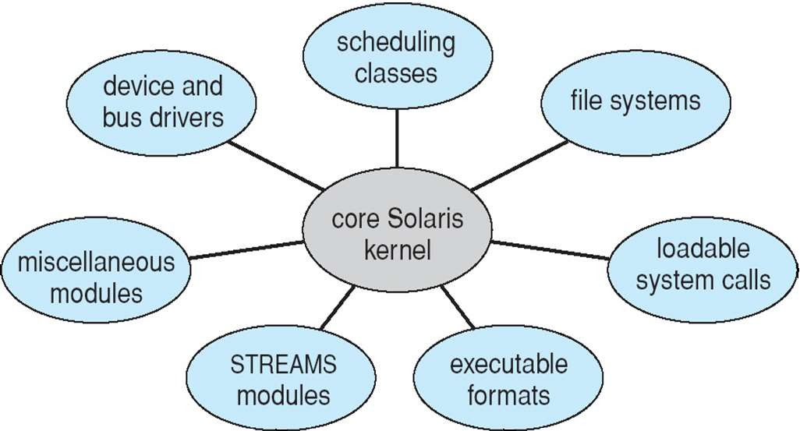
Solaris Modular Approach

Slide 12
Hybrid Systems
Most modern operating systems are actually not one pure model
Hybrid combines multiple approaches to address performance, security, usability needs
Linux and Solaris kernels in kernel address space, so monolithic, plus modular for dynamic loading of functionality
Windows mostly monolithic, plus microkernel for different subsystem
personalities
Apple Mac OS X hybrid, layered, Aqua UI plus Cocoa
programming environment
Below is kernel consisting of Mach microkernel and BSD Unix parts, plus
I/O kit and dynamically loadable modules (called kernel extensions)

Slide 13
Mac OS X Structure
graphical user interface
Aqua
application environments and services
Java Cocoa
Quicktime
BSD
kernel environment
BSD
Mach
I/O kit
kernel extensions

Slide 14








iOS
Apple mobile OS for iPhone, iPad
Structured on Mac OS X, added functionality
Does not run OS X applications natively
Also runs on different CPU architecture (ARM vs. Intel)
Cocoa Touch Objective-C API for developing
apps
Media services layer for graphics, audio, video
Core services provides cloud computing,
databases
Core operating system, based on Mac OS X kernel

Slide 15
Android
Developed by Open Handset Alliance (mostly Google)
Open Source
Similar stack to IOS
Based on Linux kernel but modified
Provides process, memory, device-driver management
Adds power management
Runtime environment includes core set of libraries and Dalvik virtual machine
Apps developed in Java plus Android API
Java class files compiled to Java bytecode then translated to executable than
runs in Dalvik VM
Libraries include frameworks for web browser (webkit), database (SQLite), multimedia, smaller libc

Slide 16
Operating-System Debugging
Debugging is finding and fixing errors, or bugs
OS generate log files containing error information
Failure of an application can generate core dump file capturing memory of the process
Operating system failure can generate crash dump file containing
kernel memory
Beyond crashes, performance tuning can optimize system performance
Sometimes using trace listings of activities, recorded for analysis
Profiling is periodic sampling of instruction pointer to look for statistical trends
Kernighan’s Law: “Debugging is twice as hard as writing the code in the first place. Therefore, if you write the code as cleverly as possible, you are, by definition, not smart enough to debug it.

Slide 17
System Boot
When power initialized on system, execution starts at a fixed memory location
Firmware ROM used to hold initial boot code
Operating system must be made available to hardware so hardware can start it
Small piece of code – bootstrap loader, stored in ROM or EEPROM
locates the kernel, loads it into memory, and starts it
Sometimes two-step process where boot block at fixed location loaded by ROM code, which loads bootstrap loader from disk
Common bootstrap loader, GRUB, allows selection of kernel
from multiple disks, versions, kernel options
Kernel loads and system is then running

Slide 18
System Calls
Programming interface to the services provided by the OS
Typically written in a high-level language (C or C++)
Mostly accessed by programs via a high-level Application Programming Interface (API) rather than direct system call use
Three most common APIs are Win32 API for Windows, POSIX API for POSIX-based systems (including virtually all versions of UNIX, Linux, and Mac OS X), and Java API for the Java virtual machine (JVM)

Slide 19
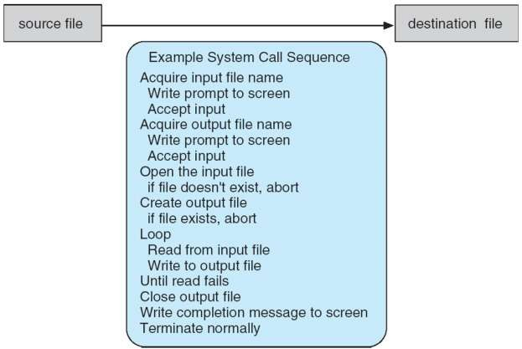
Example of System Calls
System call sequence to copy the contents of one file to another file

Slide 20
System Call Implementation
Typically, a number associated with each system call
System-call interface maintains a table indexed according to these
numbers
The system call interface invokes the intended system call in OS kernel and returns status of the system call and any return values
The caller need know nothing about how the system call is implemented
Just needs to obey API and understand what OS will do as a result call
Most details of OS interface hidden from programmer by API
Managed by run-time support library (set of functions built into libraries included with compiler)

Slide 21
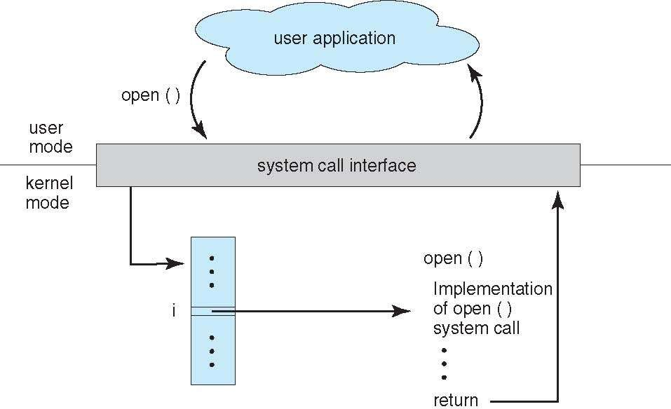
API – System Call – OS Relationship

Slide 22
System Call Parameter Passing
Often, more information is required than simply identity of desired system call
Exact type and amount of information vary according to OS and
call
Three general methods used to pass parameters to the OS
Simplest: pass the parameters in registers
In some cases, may be more parameters than registers
Parameters stored in a block, or table, in memory, and address of
block passed as a parameter in a register
This approach taken by Linux and Solaris
Parameters placed, or pushed, onto the stack by the program and
popped off the stack by the operating system
Block and stack methods do not limit the number or length of
parameters being passed

Slide 23
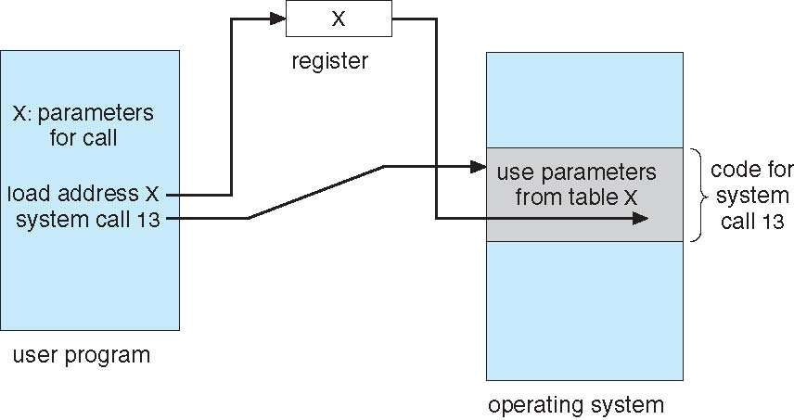
c

Slide 24
Types of System Calls
Process control
create process, terminate process
end, abort
load, execute
get process attributes, set process attributes wait for time
wait event, signal event allocate and free memory Dump memory if error
Debugger for determining bugs, single step
execution
Locks for managing access to shared data between processes

Slide 25
Types of System Calls
File management
create file, delete file
open, close file
read, write, reposition get and set file attributes
Device management
request device, release device read, write, reposition
get device attributes, set device attributes logically attach or detach devices

Slide 26
Types of System Calls (Cont.)
Information maintenance
get time or date, set time or date get system data, set system data
get and set process, file, or device attributes Communications
create, delete communication connection send, receive messages if message passing model to host name or process name
From client to server
Shared-memory model create and gain access to memory regions
transfer status information
attach and detach remote devices

Slide 27
Types of System Calls (Cont.)
Protection
Control access to resources Get and set permissions Allow and deny user access

Slide 28
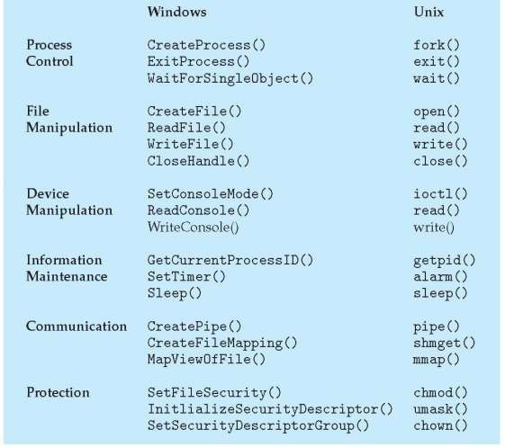
Examples of Windows and Unix System Cal s

Slide 29
QUESTION
Explain System calls. How does it differ from function call?
(RTU-2010-11)
What is the main difference between monolithic and microkernel architecture?
Explain the difference between microkernel and macro kernel?
What is the main advantage of the layered approach to system design?
What is the purpose of system calls?
Explain layered architecture with example

